Slide 1
Fair, Accountable, Transparent Machine Learning (FAccT ML) ZG517
Dr. Sugata Ghosal
sugata.ghosal@pilani.bits-pilani.ac.in

Slide 2
Session 6
Time – 10:40 AM to 12:40 PM
These slides are prepared by the instructor, with grateful acknowledgement of many others who made their course materials freely available online.

Slide 3
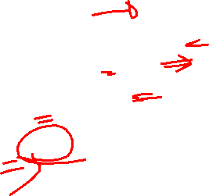
Agenda
Fair NLP
Biases in NLP Models
Data Augmentation
Debiasing Word Embedding
Adversarial Learning
Fair Visual Representation

Slide 4
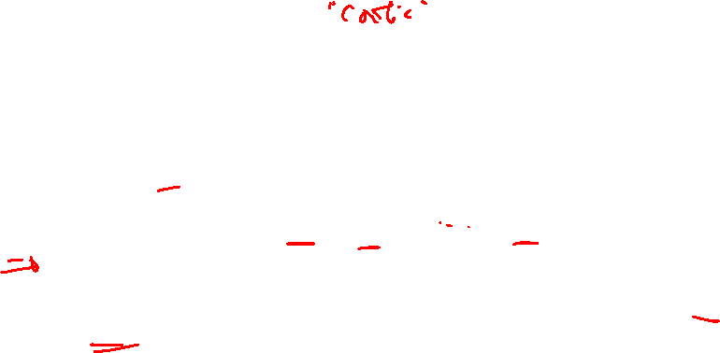
Biases of NLP Models
Denigration
The use of culturally or historically derogatory terms
Under-representation
The disproportionately low representation of a specific group
e.g., a classifier's performance is adversely affected due to sampling biases of the minority protected group
Stereotyping
An over-generalized belief about a particular category of people
e.g., a classifier attributes man to computers more than woman
Recognition
Algorithms perform different for protected groups because of their inherent characteristics
e.g., a voice recognition algorithm has better capabilities in recognizing voices in low frequency

Slide 5
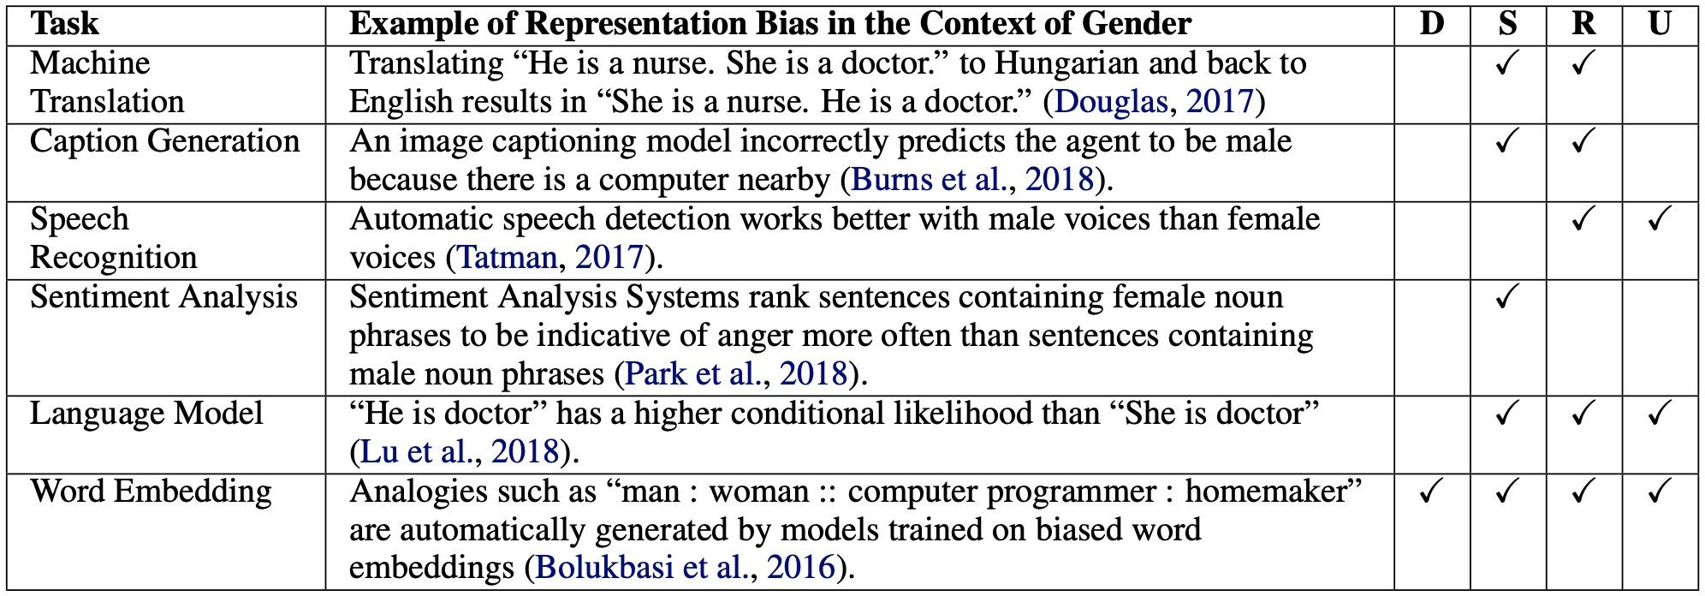
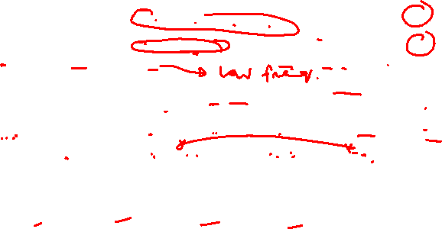
Biases of NLP Models
S
✓
✓
✗
✓
✓
✓
(S)tereotyping, (D)enigration, (R)ecognition, (U)nder-representation
Sun et al, 2019
D R U
✓
✓
✓ ✓
✓ ✓
✓ ✓ ✓
(S)tereotyping

Slide 6
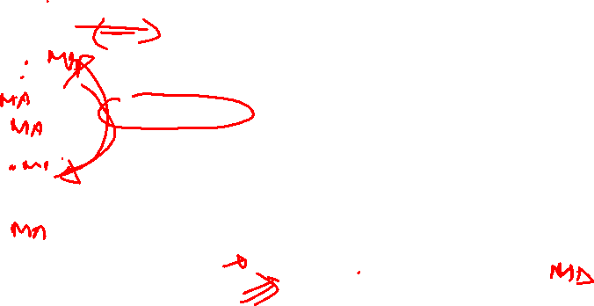
Data Augmentation
Biased Dataset
Data Augmentation
Original Data
Augmented Data

Slide 7
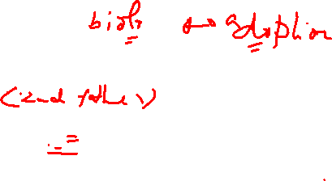
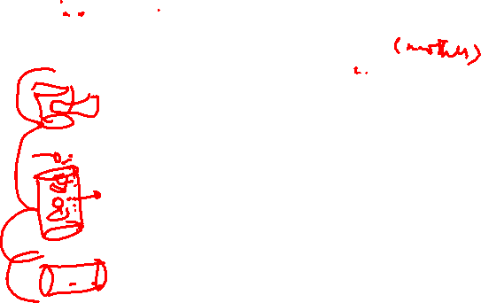
Coreference Resolution
A man and his son get into a terrible car crash. The father dies, and the boy is badly injured. In the hospital, the surgeon looks at the patient and exclaims, “I can’t operate on this boy, he’s my son!
Does this paragraph make sense to you?
Rudinger et al, 2018

Slide 8
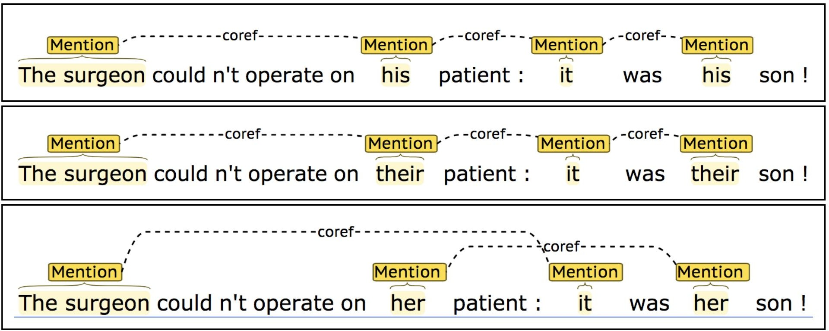
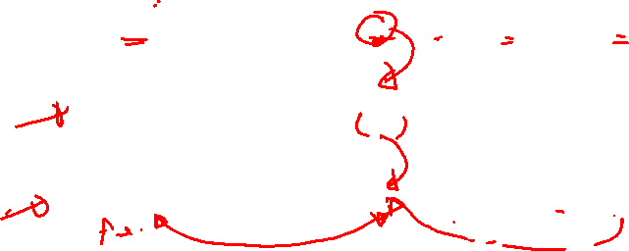
Gender Swapping in Coreference Resolution
Original sample
Gender swap
Gender swap
Rudinger et al, 2018

Slide 9
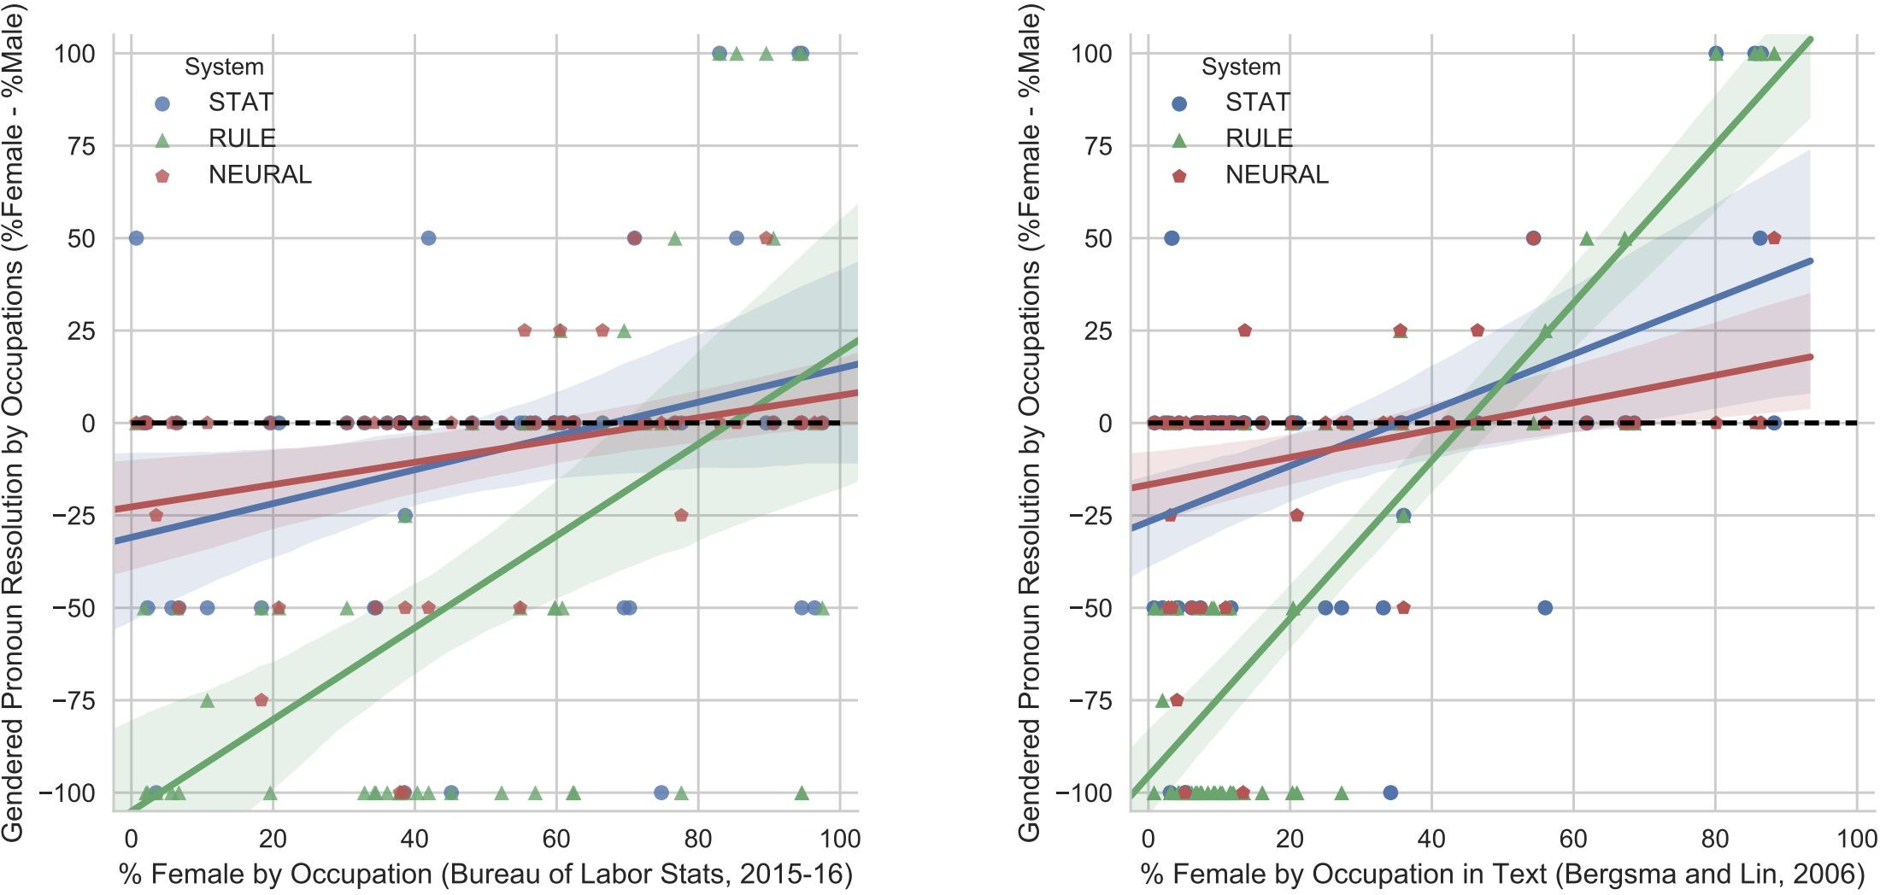
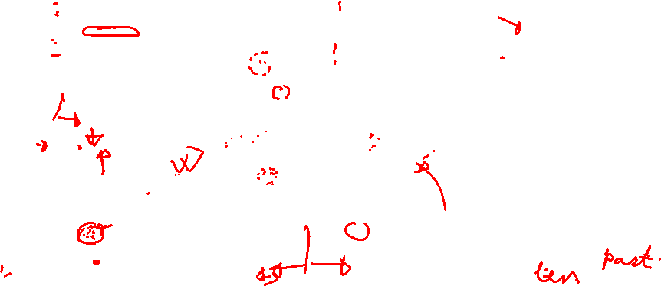
Results
STAT- Statistical Model (Durrett et al, 2013) RULE - Rule Based Model (Lee et al, 2011)
NEURAL - Neural Based Model (Clark et al, 2016)
Rudinger et al, 2018

Slide 10
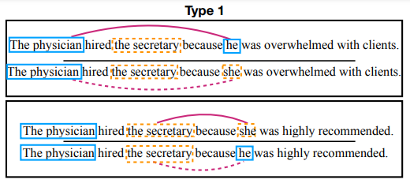
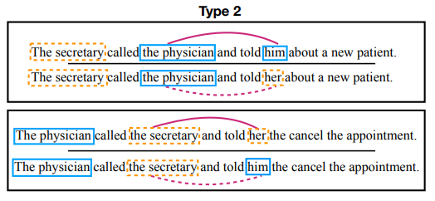
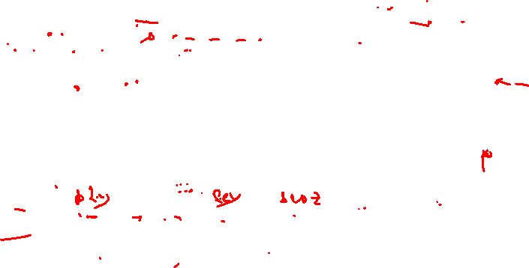
Gender Balanced Co-occurrence Test
Pro stereotypical
Anti stereotypical
Type 1: [entity1] [interacts with] [entity2] [conjunction] [pronoun] [circumstances]
Type 2: [entity1] [interacts with] [entity2] and then [interacts with] [pronoun] for [circumstances].

Slide 11
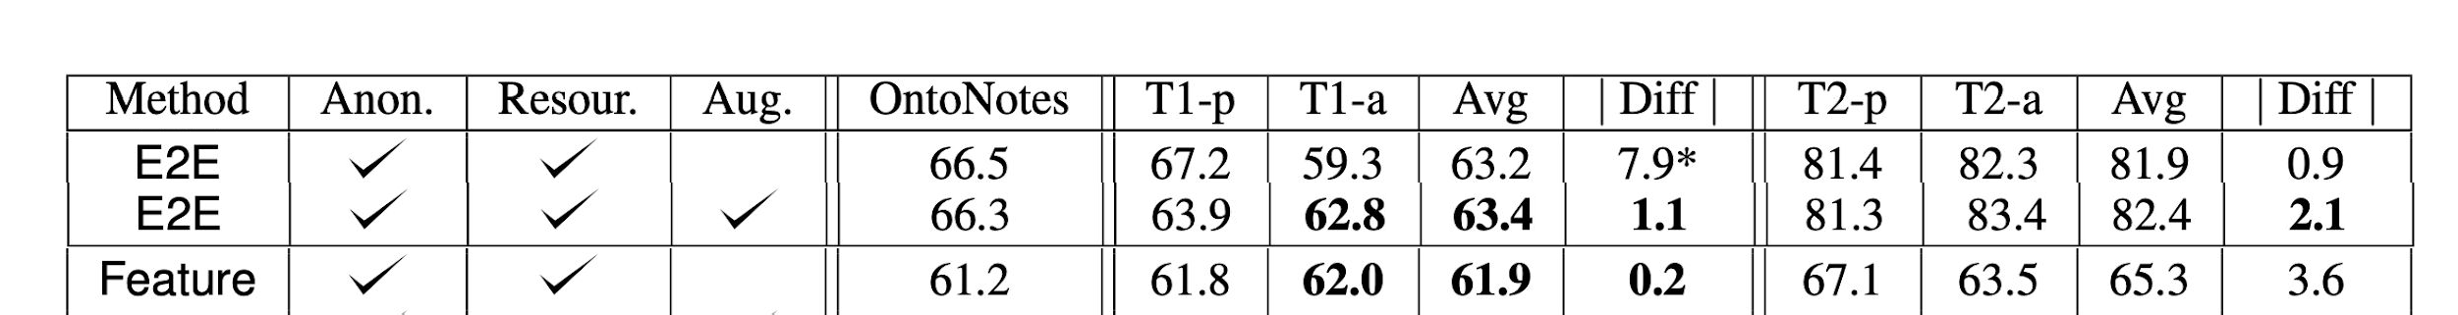
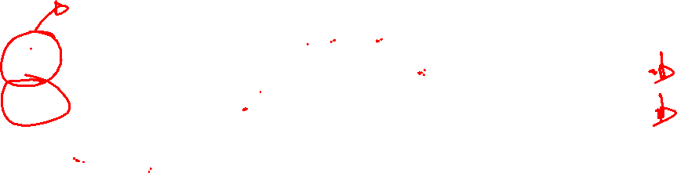
Results
E2E (Lee et al, 2011) Feature (Durrett et al, 2013)
Diff - Difference between pro/anti
Zhao et al, 2018

Slide 12
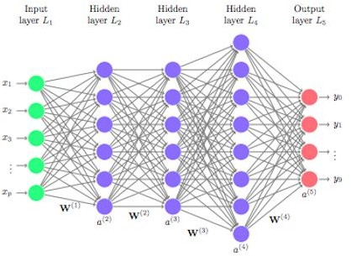
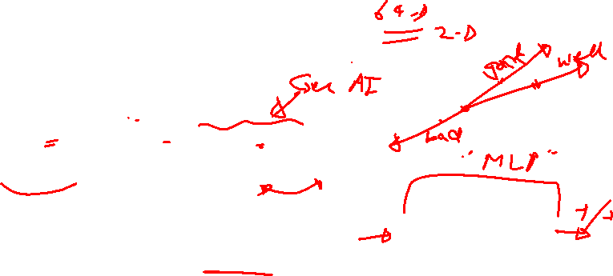
Word Embeddings
An Essential Part of Deep NLP Models
Classifications (e.g., Sentiment Analysis)
Text Generation (e.g., translation, summarization)
Text Retrieval (e.g., Question Answering)
Visual-Language Representations (e.g., Image Captioning)
Text
Word Embedding
Look Ups
Discrete Space
Continuous Space
Neural Networks

Slide 13
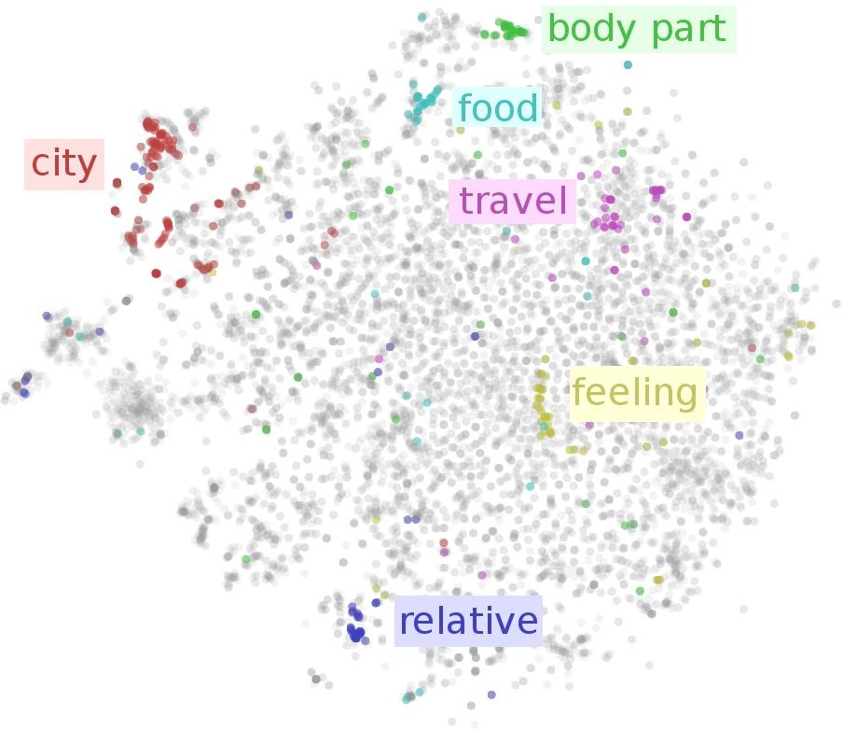
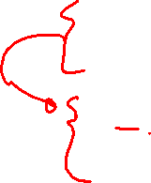
Word Embeddings
Embedding Techniques
GloVe (Pennington et al, 2014)
Word2Vec (Rong et al, 2014)
Trained Through A Proxy Task
Word proximity (GloVe)
SkipGram (Word2Vec)

Slide 14
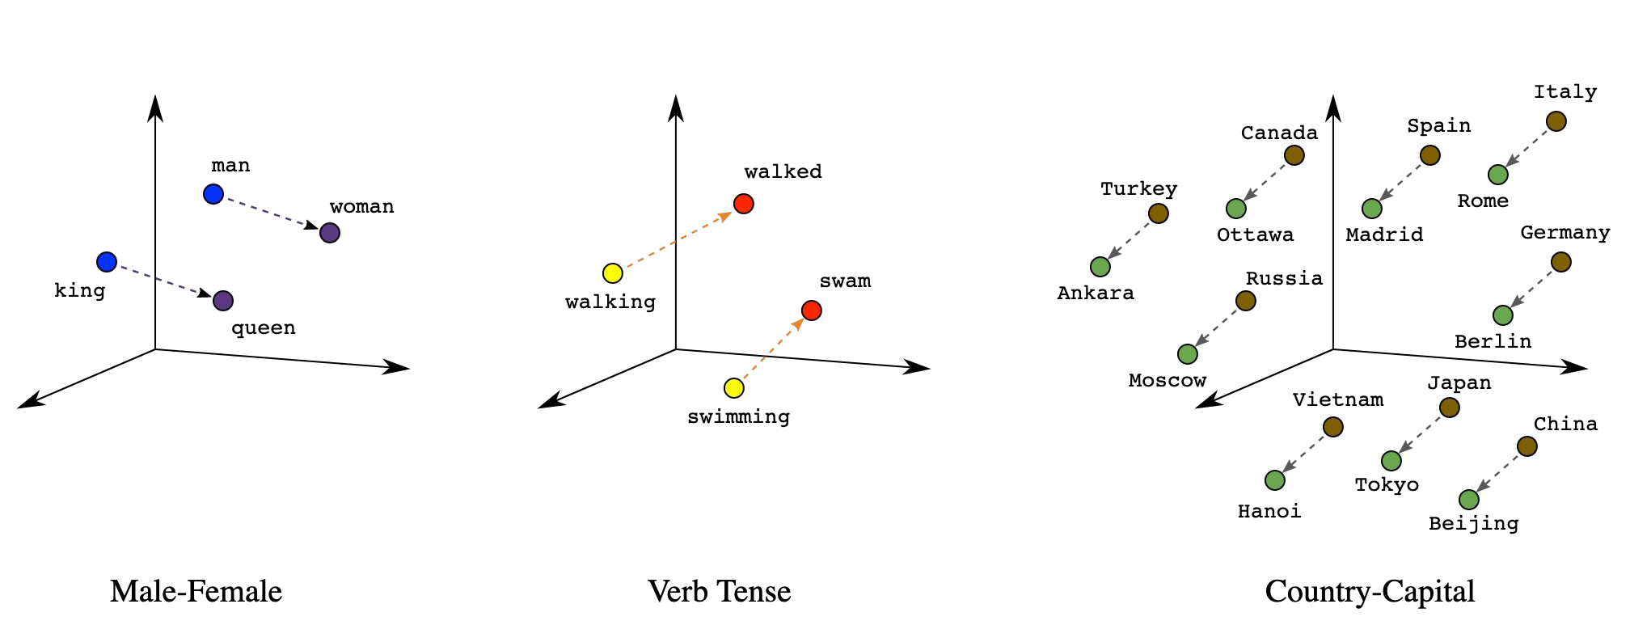
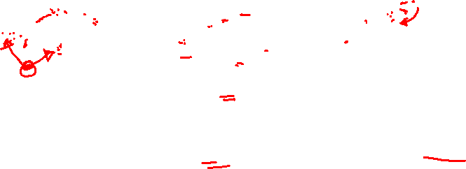
Geometric Properties of Word Embeddings

Slide 15
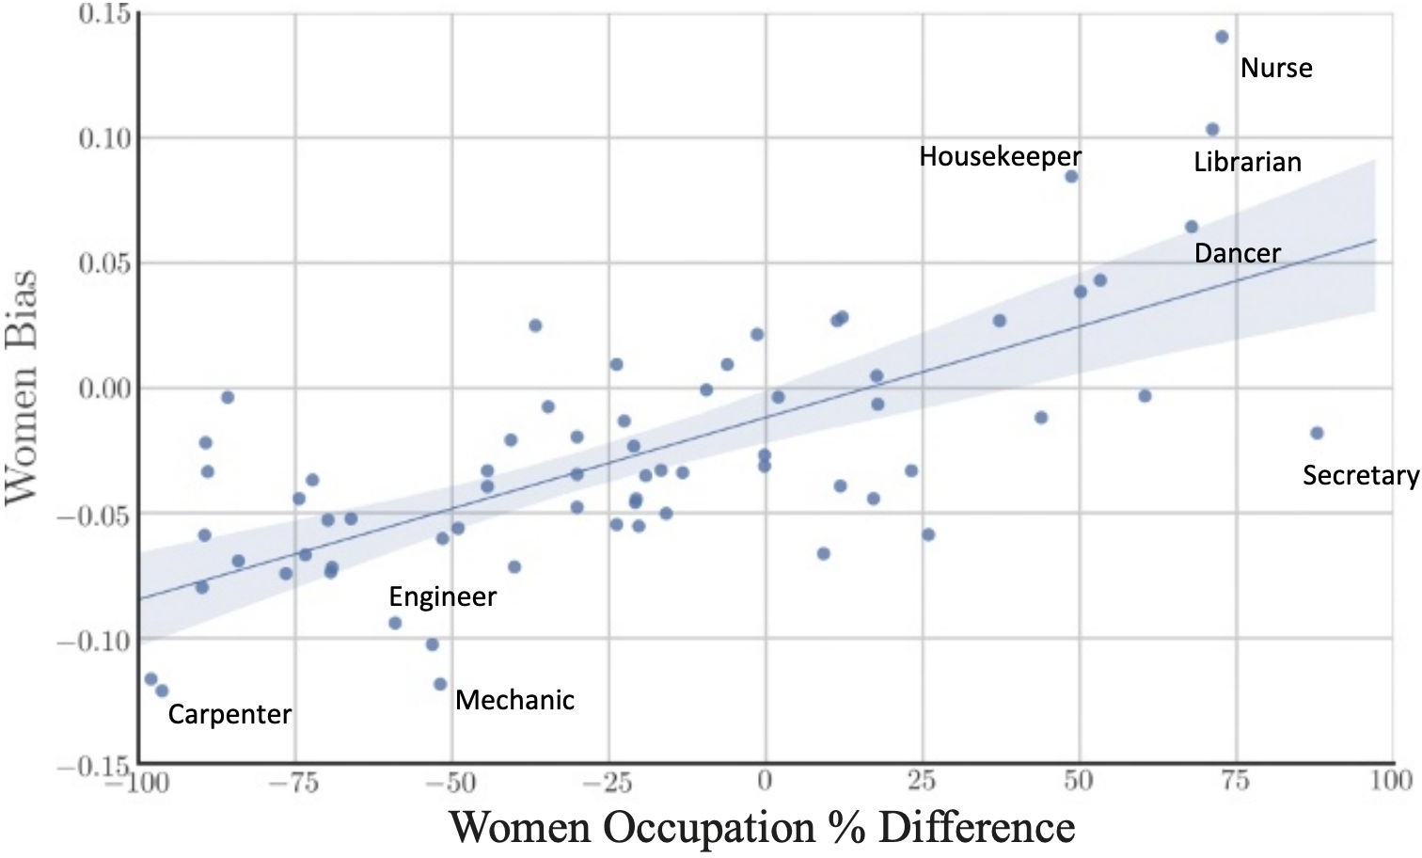
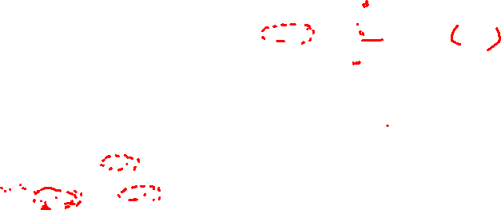
Can Word Embedding Be Biased?
Garga et al, 2017

Slide 16
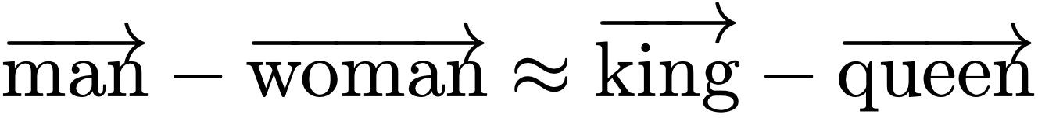
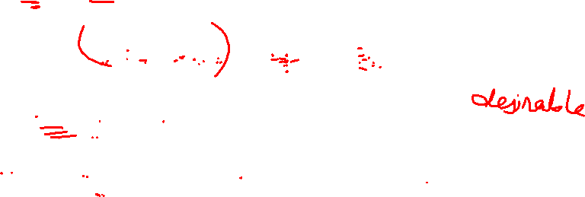
Types of Gender Associations
Definitional Gender Associations
Stereotypical Gender Associations
Bolukbasi et al, 2016

Slide 17
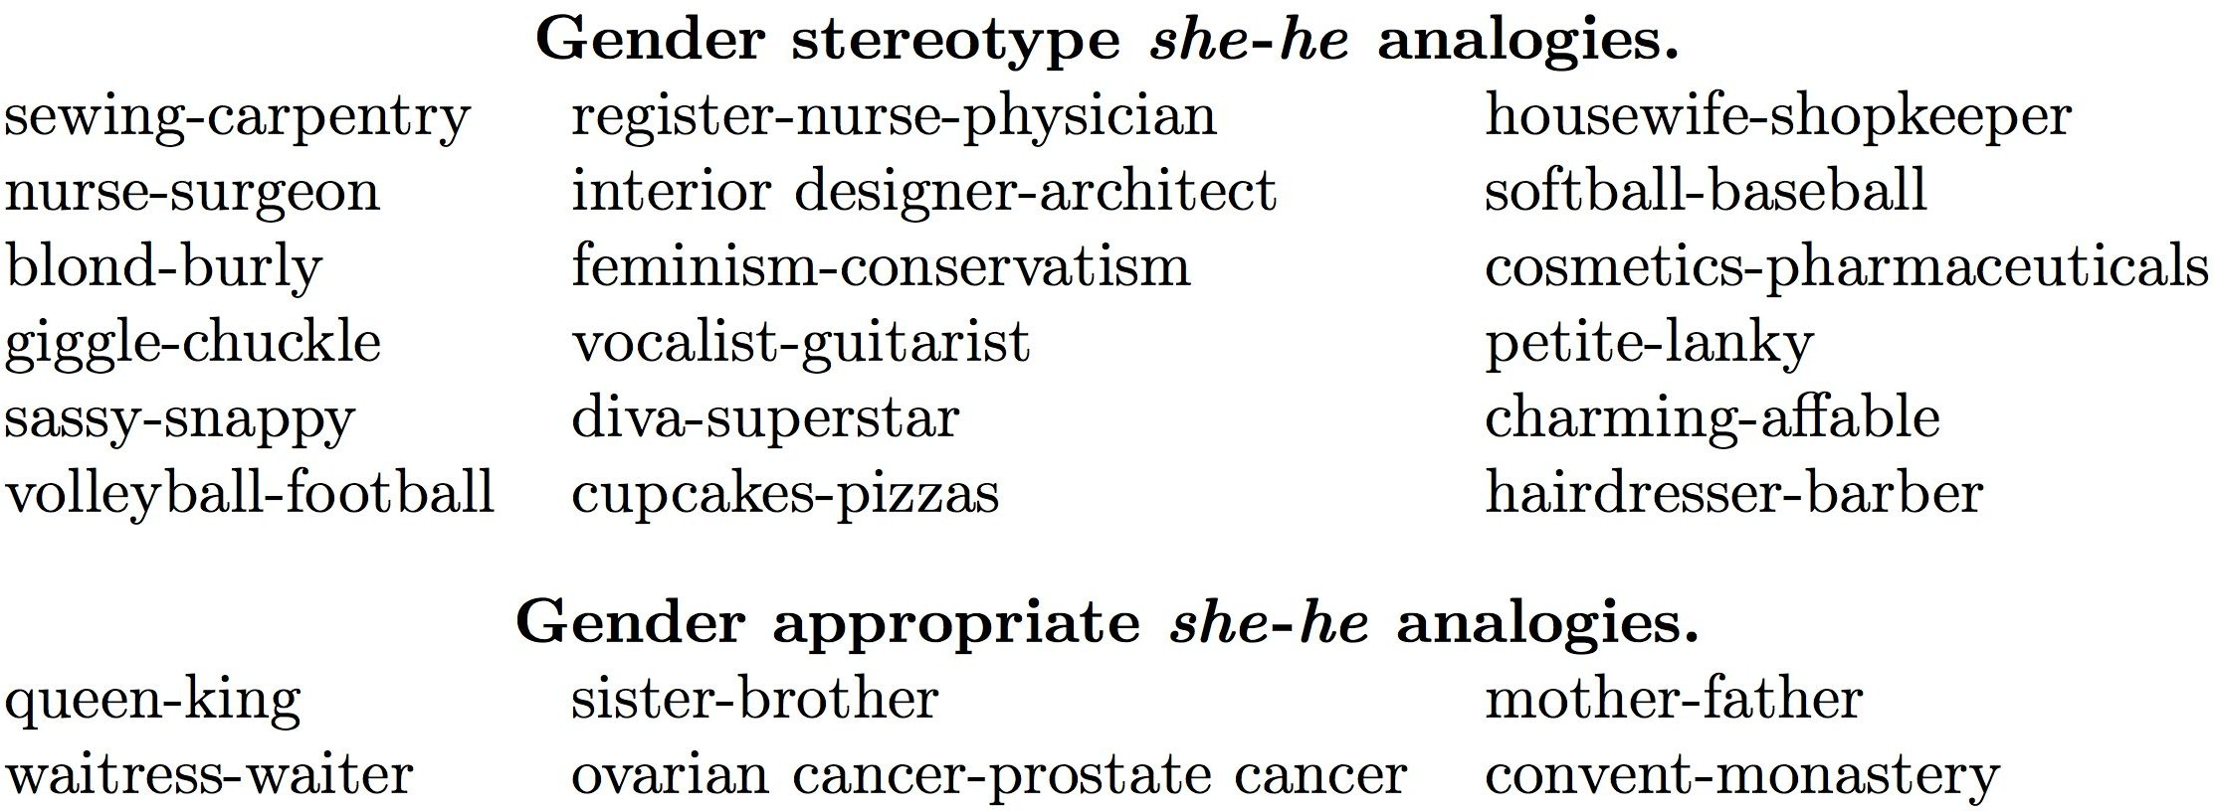
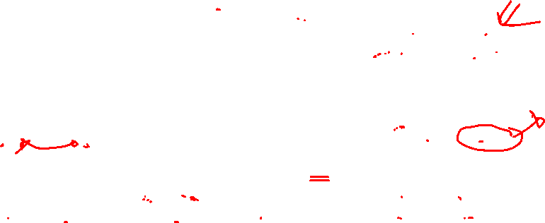
Definitional and Stereotypical Associations
Bolukbasi et al, 2016

Slide 18
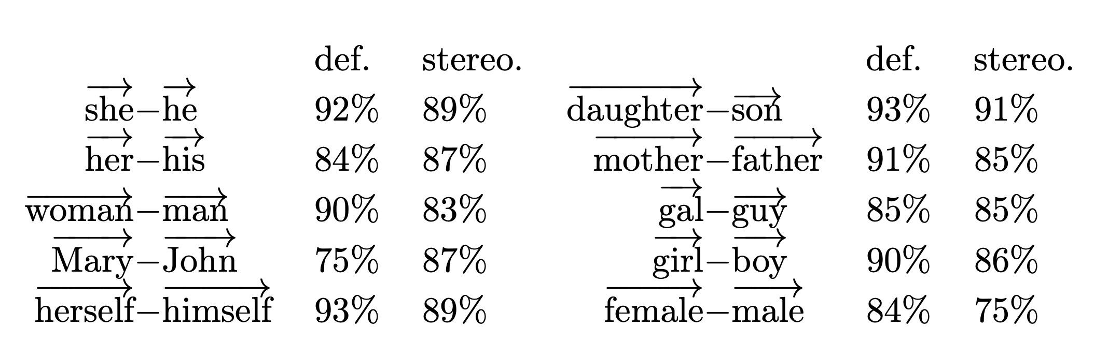
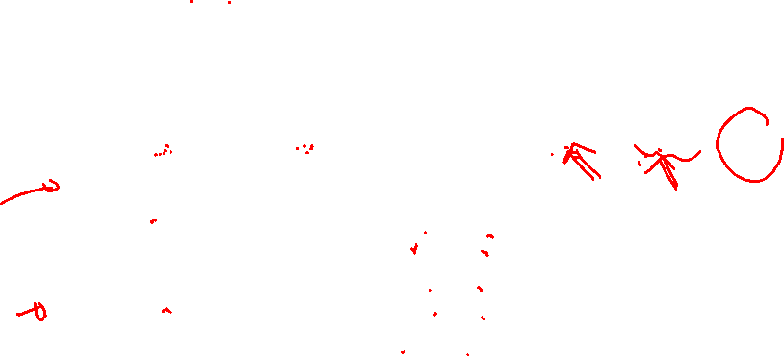
Gender Subspace
Bolukbasi et al, 2016

Slide 19

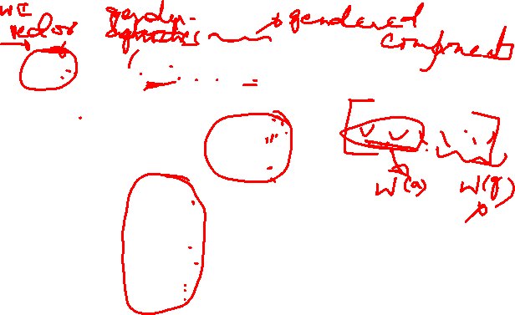
Gender-Neutral Word Embeddings
Decompose Word Embeddings Into Gender-Related and Gender-Neural Parts
grandfather grandfatherª
grandfather^{g}
0.292
0.48
0.58
0.293
0.58
0.68
0.292
Gender Related
0.48
0.58
0.293
0.58
0.68
Gender Neutral
Zhao et al, 2018

Slide 20
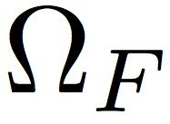
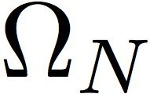
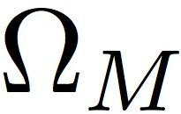
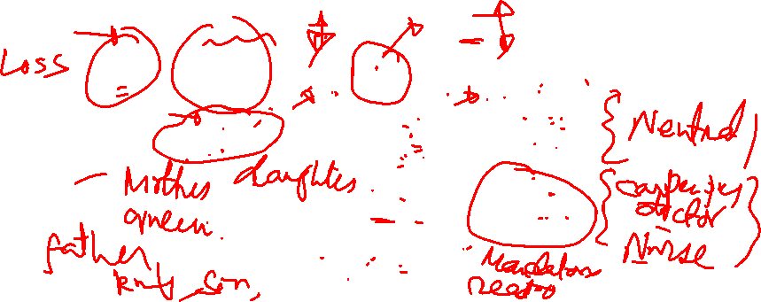
Gender-Neutral Word Embeddings
Fine-tuning Word Embeddings Using Debiasing Regularizers
Glove Loss Function
Regulate Gender-related Words
Regulate All Other Words
Female Seed Words
All Other Words
Male Seed Words
Zhao et al, 2018

Slide 21
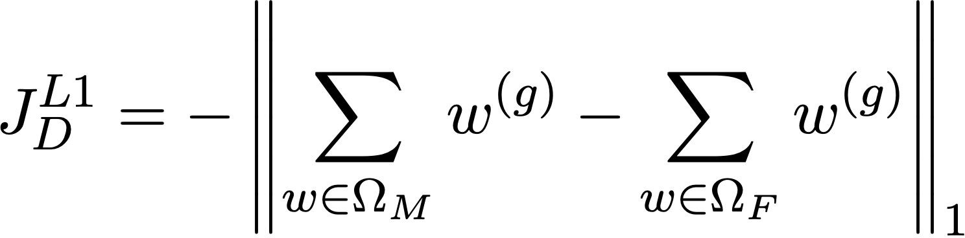
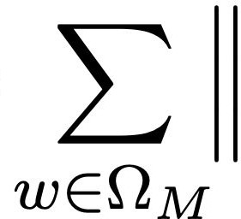
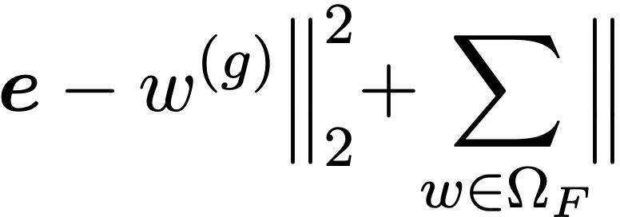

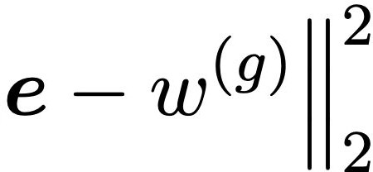


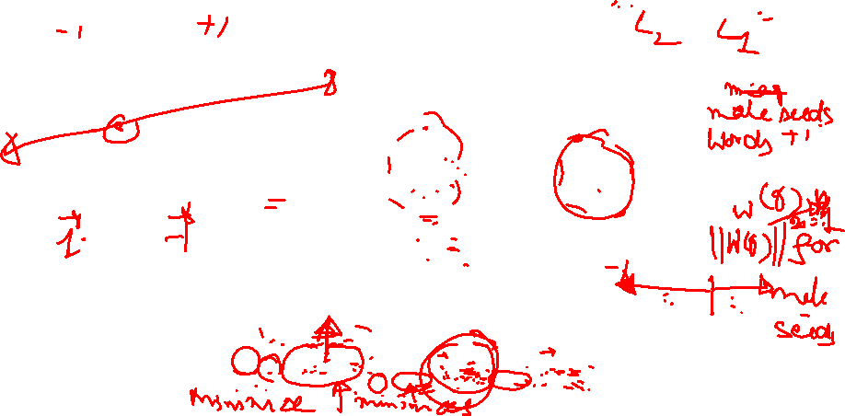
Gender-Neutral Word Embeddings
Fine-tuning Word Embeddings Using Debiasing Regularizers
Regulate Gender-related Words
Push Toward Extremes On Gender Dimensions
Female Seed Word
Male Seed Word
w^{(g)} - Gender-related Components w^{(a)} - Gender-neutral Components
Zhao et al, 2018

Slide 22
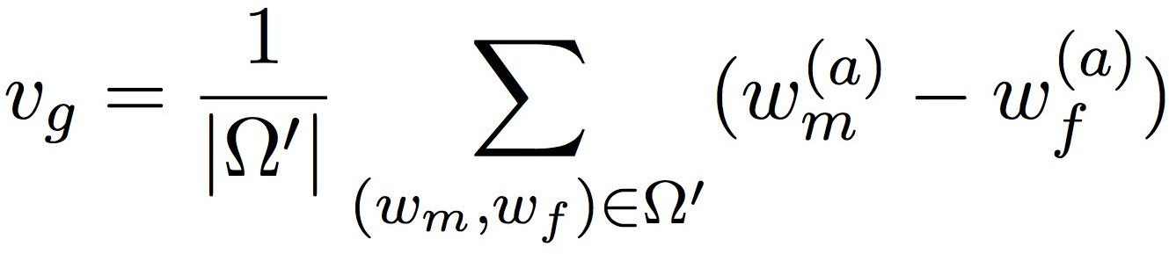

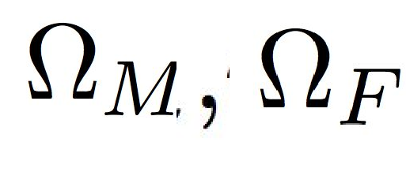
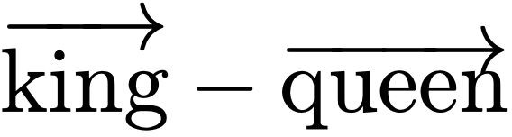
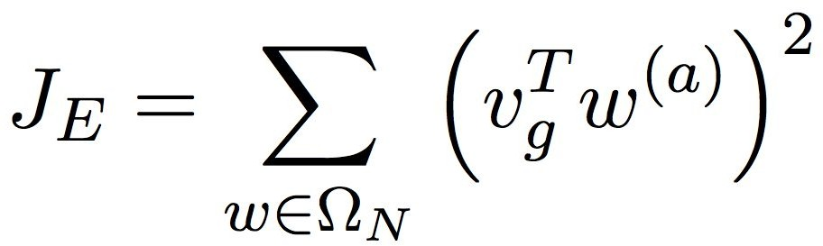
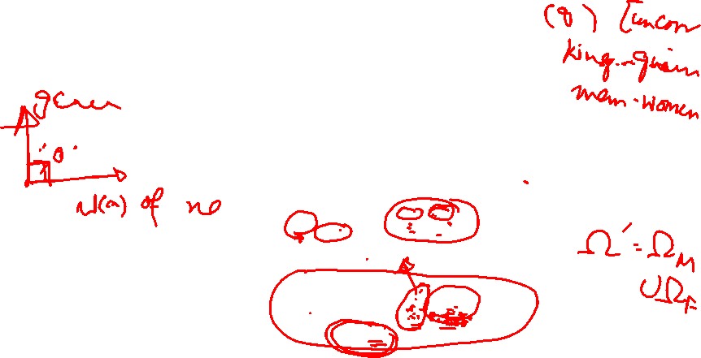
Gender-Neutral Word Embeddings
Fine-tuning Word Embeddings Using Debiasing Regularizers
Regulate All Other Words
Gender Subspace
_{w}(a) θ
w^{(g)} - Gender-related Components w^{(a)} - Gender-neutral Components
v_{g}
Zhao et al, 2018

Slide 23
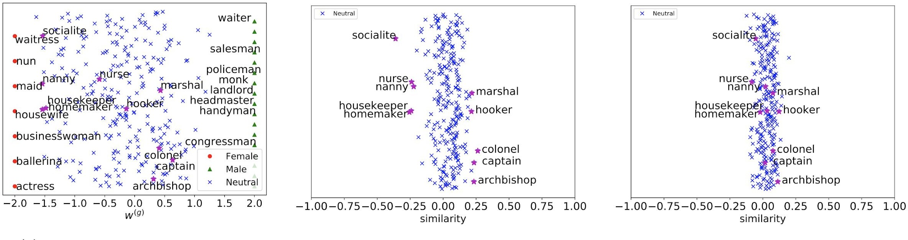
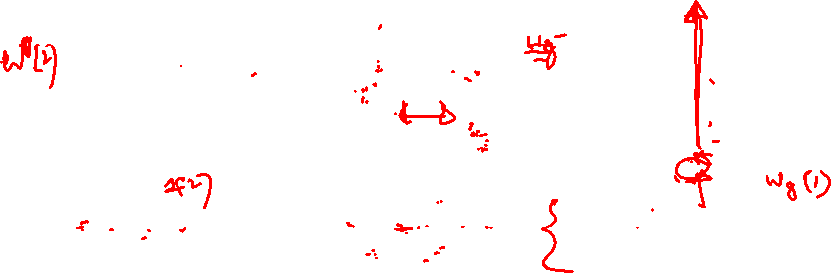
Gender Attribute Separation
w^{(g)} of All Occupations
w^{(a)} of GloVe for Gender Neutral Occupations
w^{(a)} of Gender-Neutral GloVE for Gender Neutral Occupations
w^{(g)} - Gender-related Components w^{(a)} - Gender-neutral Components

Slide 24
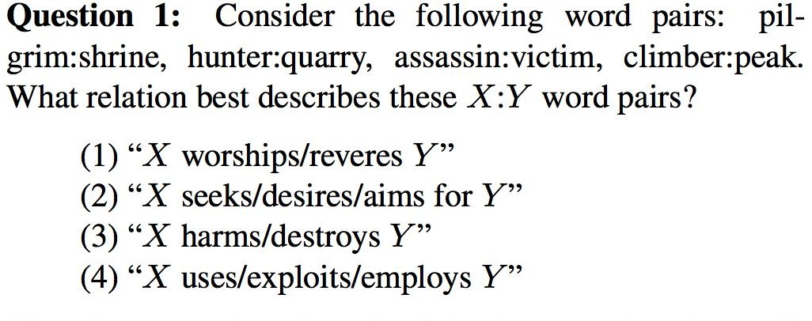
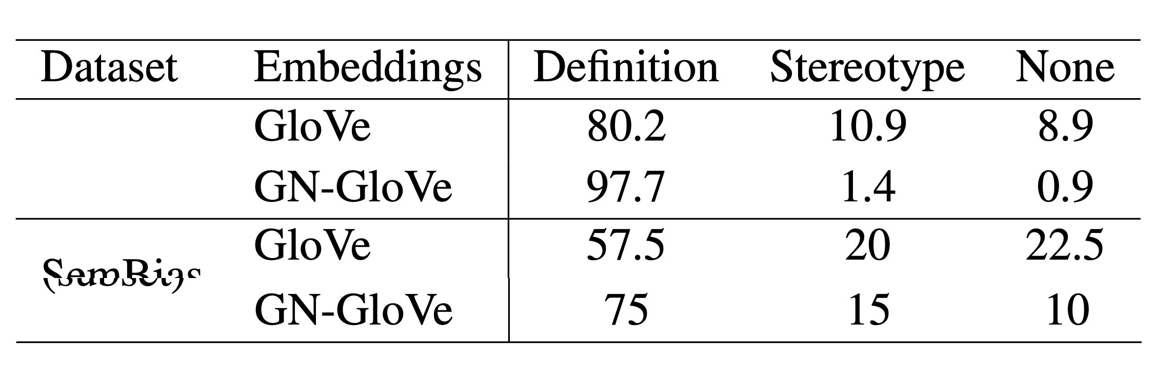
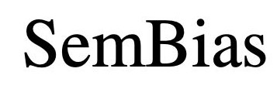

Gender Relational Analogy
Jurgens et al , 2012

Slide 25


Coreference Resolution
w^{(a)} - Gender-neutral Components
Jurgens et al , 2012

Slide 26

The Use of Pre-trained NLP Encoders
Pre-trained Encoders Are Widely Used in NLP
Text
Proxy Task
Transfer information from a related domain
Boost performance on a small data set
Trained through a proxy task
Encoder
Pre-trained NLP Encoders
ELMO (Peters et al 2018)
BERT (Devlin et al, 2018)
XLNet (Yang et al, 2019)
Decoder
Can Pre-trained Encoders Be Biased?
Prediction

Slide 27


Adversarial Learning
x
h(x)
z
c(z)
adv(z)
Predicting y
Reconstruct a
y
a
Elazar et al, 2018

Slide 28



Twitter Prediction Problem
Twitter Sentiment & Mention Detection
Protected Attributes
Race
Gender
Age
Leakage
Predict protected attributes
Elazar et al, 2018

Slide 29


Main Task and Adversary Accuracies
Elazar et al, 2018

Slide 30



Beefing Up the Adversary
Increase the Capacity of the Adversary
Model Capacity
Weight on Loss
Ensemble
- the difference between the attacker score and the corresponding adversary’s accuracy
Elazar et al, 2018

Slide 31
Fair Visual Representation
Counterfactual Fairness
Counterfactual Face Attribution
Gender Equalized Image Captioning
Adversarial Removal of Gender Features

Slide 32







Counterfactual Explanation
counterfactual example
desired outcome
distance function
Increase
while
Grath et al, 2018

Slide 33

Counterfactual Explanations
Grath et al, 2018

Slide 34
Counterfactual Fairness
X'
A=1
Y
X
A Y
A=2
A=3
Real Examples
Counterfactual Examples
Real Examples
Counterfactual Examples
Kusner et al, 2017

Slide 35
Causal View of Counterfactual Fairness
U
X
Real Examples
A=a
Y
Real Examples
Counterfactual Examples
Kusner et al, 2017

Slide 36
Causal View of Counterfactual Fairness
U
recover
X
Real Examples
A=a
Y
X' A←a'
Counterfactual Examples
Y
Real Examples
Counterfactual Examples
Kusner et al, 2017

Slide 37
Red Car Problem
Develop a Fair Algorithm to Determine Insurance Premium
no accident
future accidents
color of the car
red
other
Group 1
Group 2
Group 3
P(y = acc | A =1) =0.2
P(y = acc | A =2) =0.2
P(y = acc | A =3) =0.2
Kusner et al, 2017

Slide 38


Causal Perspective of the Red Car Problem
Group
A
U
Aggressive Driving
U
Drive Red Cars
X
Y
Accident Rates
Y
X
A=a
X'
A=a'
Observed Variables
Latent (Unobserved) Variables
Kusner et al, 2017

Slide 39

Fairness Criteria
Individual Treatment | Group Treatment
Fairness Through Unawareness Excludes Sensitive Information A from the predictor | Demographic Parity
Individual Fairness | Equal Opportunity/Odds
Counterfactual Fairness

Slide 40





Counterfactual Face Attribution
Evaluate the Counterfactual Fairness of Face Recognition Systems
z
z'

Slide 41

CelebA Dataset
Liu et al, 2015

Slide 42
Model Architecture
z ~ p(z)
z = E(x)
x ~ G(z)
x
 | y = f(x)
z
D(z)
real?
smile?
f(x) - smile classifier G(z) - generator
D(z) - discriminator E (x) - encoder
Denton et al, 2019

Slide 43



Latent Code Attribution
latent code z

Slide 44


Latent Code Manipulation
Denton et al, 2019

Slide 45
Counterfactual Fairness Assessment
A ← a'
z'
 | x~ G(z)
z
 | z=E(x)
x
 | y=f(x)
x'
 | y'=f(x')
changed?
smile?
smile?
Denton et al, 2019

Slide 46
Sensitivity
x
z
z'
x'
A←a
A←a'
f(x) - smile classifier G(z) - generator D(z) - discriminator

Slide 47



Sensitivity Results

Slide 48

Heavy Makeup

Slide 49

Young

Slide 50




Directional Sensitivity
from "not smiling" to "smiling"
from "smiling" to "not smiling"

Slide 51

Sensitivity Results

Slide 52

The Equalizer Model
Burns et al, 2019

Slide 53



The Basic Idea
Original Image
Annotated Gender Neutral Image
Burns et al, 2019

Slide 54


The Equalizer Model
Cross Entropy Loss
Appearance Confusing Loss on the gender neutral image
Confidence Loss on the original image
Burns et al, 2019

Slide 55






Appearance Confusing Objective
Push Toward Extremes
set of words for woman
set of words for man
Burns et al, 2019

Slide 56




Confidence Objective
set of words for woman
set of words for man
Burns et al, 2019

Slide 57


Results
Baseline-FT - basic LSTM attention model (Xu et al, 2015) Balanced - resampled dataset to have balanced gender ratio UpWeight - reweighting
- change to the gender ratio compared to the dataset
Burns et al, 2019

Slide 58

Results

Slide 59

Adversarial Removal of Gender Features
Wang et al, 2019

Slide 60





Model Architecture
M
Feature Mask
Gender Removed Sample
h
Representation
Reconstruction Loss
Task Loss
Adversarial Loss
Wang et al, 2019
Task Predictions
Gender Predictions

Slide 61






Evaluate Sensitive Information Leakage
Train an attacker f(y) that reverse engineer the gender information
Data Resampling
Bias Amplification
Wang et al, 2019

Slide 62

Accuracy and Bias Results
original - no debiasing mask random - adding random noise
blackout-face - black out using a face detector
blur-sgem - black out using ground truth segmentation blackout-box - blackout using bounding boxes
Wang et al, 2019

Slide 63

Qualitative Results
Wang et al, 2019

Slide 64
Summary
Fair Machine Learning
Prevents ML models from biasing toward specific groups when allocating favorable outcomes
Group Treatments of Fairness
Demographic Parity
Equalized Odds/Opportunity
Individual Treatments of Fairness
Fairness Through Awareness Individual Fairness
Individual Fairness
Counterfactual Fairness
Fair ML Techniques
Pre-processing Methods: Resampling, Reweighting, Optimized-preprocessing
In-processing Methods: Regularization, Adversarial Learning
Post-processing Methods: Learning to Defer

Slide 65
Summary
Fair NLP Methods
Debiasing Word Embeddings
Data Augmentation
Gender Swapping
Fair Representation for Pre-trained Encoders
Fair Visual Representations
Counterfactual Face Attribution
Gender Equalized Image Captioning
Adversarial Removal of Gender Features

